Slide 1
Instructor Materials Chapter 4: Protecting the Organization
Introduction to Cybersecurity v2.0
Notes:
Cisco Networking Academy Program
Introduction to Cybersecurity v2.0
Chapter 4: Protecting the Organization

Slide 2
Instructor Materials – Chapter 4 Planning Guide
This PowerPoint deck is divided in two parts:
Instructor Planning Guide
Information to help you become familiar with the chapter
Teaching aids
Instructor Class Presentation
Optional slides that you can use in the classroom
Begins on slide # 8
Note: Remove the Planning Guide from this presentation before sharing with anyone.
Notes:
2

Slide 3
Introduction to Cybersecurity
Planning Guide
Chapter 4: Protecting the Organization
Notes:
Course Planning Guide
Chapter 4: Protecting the Organization

Slide 4
Chapter 4: Activities
What activities are associated with this chapter?
Page # | Activity Type | Activity Name
4.1.1.2 | Interactive Activity | Identify the Firewall Type
4.1.1.4 | Interactive Activity | Identify the Port Scan Response
4.1.2.2 | Interactive Activity | Identify the Security Appliance
4.2.2.2 | Interactive Activity | Order the Stages of the Kill Chain
4.3.4.2 | Interactive Activity | Identify Cybersecurity Approach Terminology
Notes:
4

Slide 5
Chapter 4: Assessment
Students should complete Chapter 4, “Assessment” after completing Chapter 4.
Quizzes and other activities can be used to informally assess student progress.
Notes:
5

Slide 6
Chapter 4: Best Practices
Prior to teaching Chapter 4, the instructor should:
Complete Chapter 4, “Assessment.”
Review the Additional Resources and Activities document in the Student Resources for possible additional resources and activities.
Notes:
6

Slide 7


Slide 8
Chapter 4: Protecting the Organization
Introduction to Cybersecurity v2.0
Notes:
Cisco Networking Academy Program
Introduction to Cybersecurity v2.0
Chapter 4: Protecting the Organization

Slide 9
Chapter 4 - Sections & Objectives
4.1 Firewalls
Explain techniques to protect organizations from cyber attacks.
4.2 Behavior Approach to Cybersecurity
Explain the behavior-based approach to cybersecurity.
4.3 Cisco’s Approach to Cybersecurity
Explain the Cisco approach to providing cybersecurity.
Notes:
9

Slide 10
4.1 Firewalls
Notes:
Cisco Networking Academy Program
Introduction to Cybersecurity v2.0
Chapter 4: Protecting the Organization

Slide 11
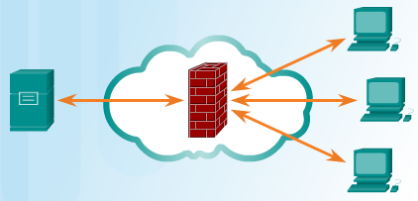
Firewalls Firewall Types
Firewall Types
Control or filter incoming or outgoing communications on a network or device
Can you name a few types of firewalls?
Port Scanning
Process of probing a computer, server or other network hosts for open ports
Port numbers are assigned to each running application on a device.
Reconnaissance tool to identify running OS and services
Notes:
4.1 – Firewalls
4.1.1 – Firewall Types

Slide 12

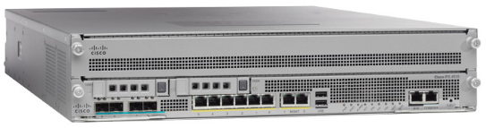
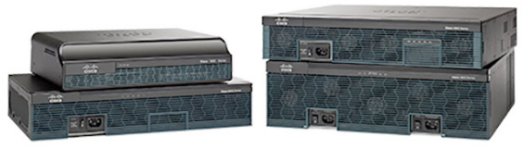
Firewalls Security Appliances
Can you name a few security appliances?
What are some of their functions?
Notes:
4.1 – Firewalls
4.1.2 – Security Appliances

Slide 13
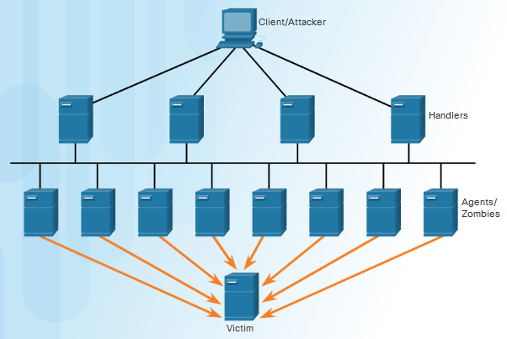
Firewalls Detecting Attacks in Real Time
Detect and response to zero-day attacks
Real Time Scanning from Edge to Endpoint
Actively scan for attacks using firewall and IDS/IPS network devices
Malware detection
Detect network anomalies using context-based analysis and behavior detection
DDoS Attacks requires real time response and detection
Notes:
4.1 – Firewalls
4.1.3 – Detecting Attacks in Real Time

Slide 14
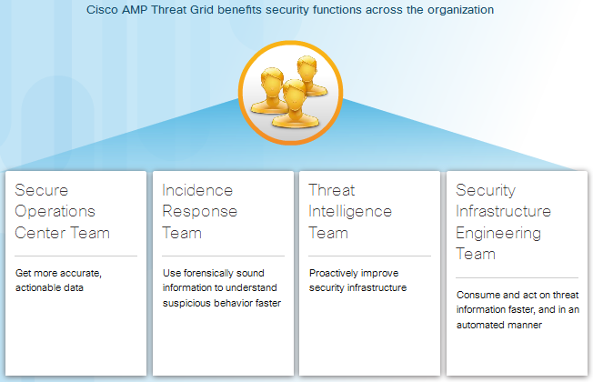
Firewalls Detecting Malware
Protecting Against Malware
Notes:
4.1 – Firewalls
4.1.4 – Detecting Malware

Slide 15
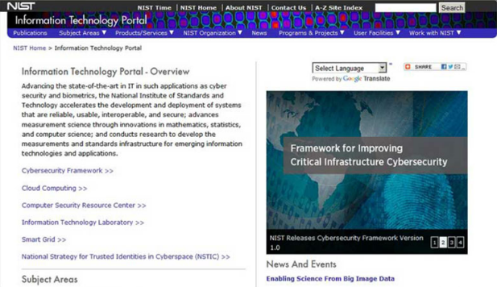
Firewalls Security Best Practice
Some of security best practices are:
Physical security measures
Human resources security measures
Employ access control
Can you list more?
Notes:
4.1 – Firewalls
4.1.5 – Security Best Practice

Slide 16
4.2 Behavior Approach to Cybersecurity
Notes:
Cisco Networking Academy Program
Introduction to Cybersecurity v2.0
Chapter 4: Protecting the Organization

Slide 17
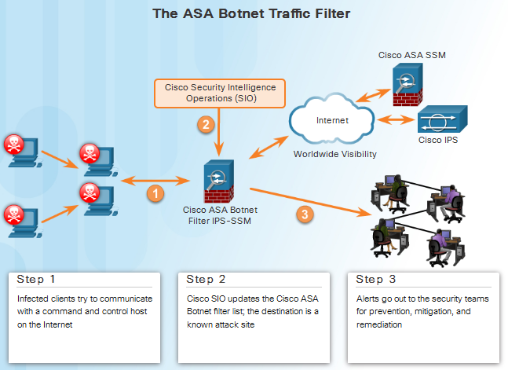
Behavior Approach to Cybersecurity Botnet
Botnet
A group of bots connect through the Internet
Controlled by malicious individuals or groups
Bot
Typically infected by visiting a website, opening an email attachment, or opening an infected media file
Notes:
4.2 – Behavior Approach to Cybersecurity
4.2.1 – Botnet

Slide 18
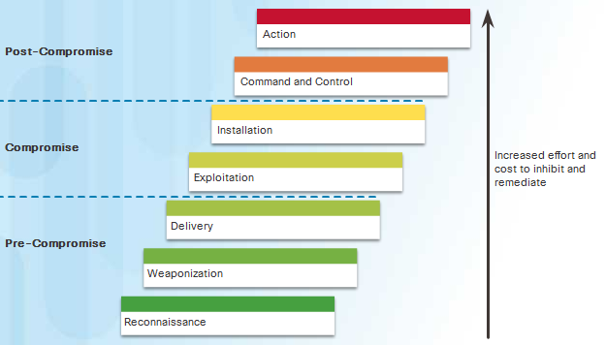
Behavior Approach to Cybersecurity Kill Chain
What are the stages in a Kill Chain?
Notes:
4.2 – Behavior Approach to Cybersecurity
4.2.2 – Kill Chain

Slide 19
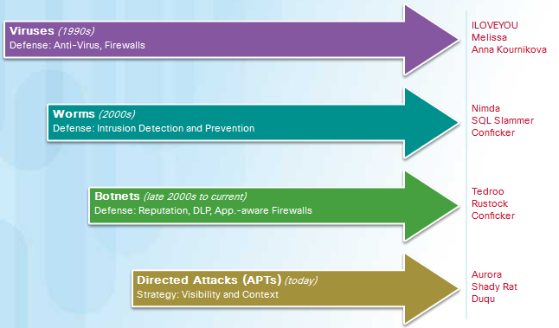
Behavior Approach to Cybersecurity Behavior-Based Security
Honeypots
Lures the attacker by appealing to the attackers’ predictable behavior
Captures, logs and analyze the attackers’ behavior
Administrator can gain more knowledge and build better defense
Cisco’s solution
Uses behavior-based detection and indicators
Provide greater visibility, context and control
Notes:
4.2 – Behavior Approach to Cybersecurity
4.2.3 – Behavior-Based Security

Slide 20
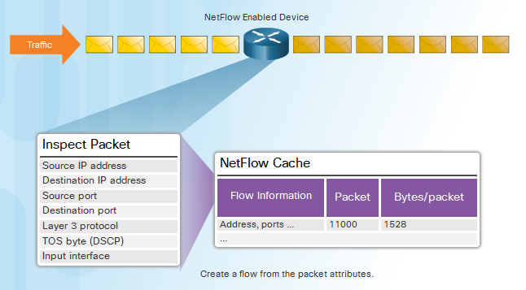
Behavior Approach to Cybersecurity NetFlow and Cyberattacks
NetFlow
Gather information about data flowing through a network
Important components in behavior-based detection and analysis
Establish baseline behaviors
Notes:
4.2 – Behavior Approach to Cybersecurity
4.2.4 – NetFlow and Cyberattacks

Slide 21
4.3 Cisco’s Approach to Cybersecurity
Notes:
Cisco Networking Academy Program
Introduction to Cybersecurity v2.0
Chapter 4: Protecting the Organization

Slide 22


Cisco’s Approach to Cybersecurity CSIRT
Computer Security Incident Response Team
help ensure company, system, and data preservation by performing comprehensive investigations into computer security incidents
provides proactive threat assessment, mitigation planning, incident trend analysis, and security architecture review
Notes:
4.3 – Cisco’s Approach to Cybersecurity
4.3.1 – CSIRT

Slide 23

Cisco’s Approach to Cybersecurity Security Playbook
Collection of repeatable queries against security event data sources that lead to incident detection and response
What does it need to accomplish?
Detect malware infected machines.
Detect suspicious network activity.
Detect irregular authentication attempts.
Describe and understand inbound and outbound traffic.
Provide summary information including trends, statistics, and counts.
Provide usable and quick access to statistics and metrics.
Correlate events across all relevant data sources.
Notes:
4.3 – Cisco’s Approach to Cybersecurity
4.3.2 – Security Playbook

Slide 24
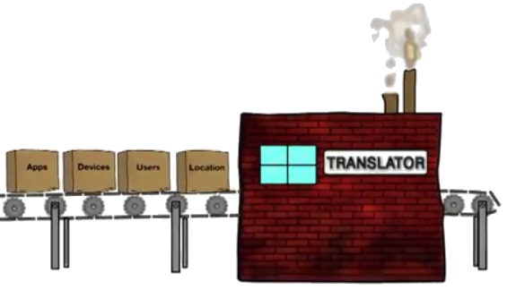
Cisco’s Approach to Cybersecurity Tools for Incident Prevention and Detection
SIEM – Security Information and Event Management
Software that collects and analyzes security alerts, logs and other real time and historical data from security devices on the network
DLP – Data Loss Prevention
Stops sensitive data from being stolen or escaped from the network
Designs to monitor and protect data in three different states
Cisco Identity Services Engine (Cisco ISE) and TrustSec
Uses role-based access control policies
Notes:
4.3 – Cisco’s Approach to Cybersecurity
4.3.3 – Tools for Incident Prevention and Detection

Slide 25
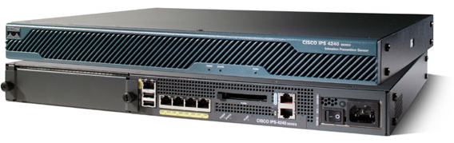
Cisco’s Approach to Cybersecurity IDS and IPS
IDS – Intrusion Detection System
Usually placed offline
Does not prevent attacks
Detect, log, and report
IPS – Intrusion Prevention System
Ability to block or deny traffic based on a positive rule or signature match
IDS/IPS system
Snort
Sourcefire (Cisco)
Notes:
4.3 – Cisco’s Approach to Cybersecurity
4.3.4 – IDS and IPS

Slide 26
4.4 Chapter Summary
Notes:
Cisco Networking Academy Program
Introduction to Cybersecurity v2.0
Chapter 4: Protecting the Organization

Slide 27
Chapter Summary Summary
Describe the various types of firewalls and security appliances.
Describe different methods of detecting malware and attacks in real time.
Describe security best practices for organizations.
Define botnet, kill chain, and behavior-based security.
Explain how Netflow can help defend against cyberattacks.
Identify the function of CSIRT within Cisco.
Explain the purpose of a security playbook.
Identify tools used for incident prevention and detection.
Define IDS and IPS.
Notes:
4.4.1.1 - Summary

Slide 29


